Slide 1

Department of CSIT
COURSE NAME
FOUNDATIONS OF CLOUD-NATIVE COMPUTING & DEVOPS
COURSE CODE –24CS2260F
Topic:
Test pyramid
Session -

Slide 2
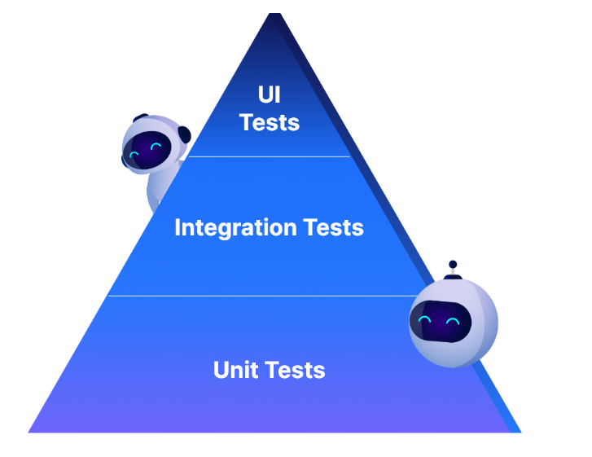
The software testing pyramid is a way to organize and plan how to test different parts of a software project. It shows the best balance of three main types of tests: unit tests, integration tests, and end-to-end (E2E) tests.

Slide 3
Example:
Let’s say you're working on an online shopping website:
Unit tests: Test if the function that calculates the total price of items in a cart works correctly.
Integration tests: Test if the checkout process works by connecting the cart with the payment system and confirming the payment goes through.
E2E tests: Test the entire shopping experience, from browsing items to completing a purchase and receiving a confirmation email.
In the pyramid, you’d have many unit tests, fewer integration tests, and only a few E2E tests at the top. This helps balance speed, cost, and coverage to keep the project efficient.

Slide 4
Unit Tests: The Base of the Pyramid
Test individual parts: Unit tests check small parts of code (like functions or classes) in isolation.
Quick feedback: They run fast, giving developers immediate feedback to catch bugs early.
Low cost: Unit tests are cheap to run and help detect bugs early, preventing expensive fixes later.
Better design: They encourage developers to write code that’s easier to test and maintain.
Benefits of Unit Testing
Fast execution: Unit tests run in milliseconds, speeding up development.
Test-driven development: They help write tests before code, ensuring the code is testable.
Early bug detection: Bugs are caught early when they're easiest and cheapest to fix.
Developer ownership: Developers write and maintain their own unit tests, improving quality.

Slide 5
Challenges of Unit Testing
Mocking dependencies: Creating fake versions of services like databases can be complex.
Isolation issues: Unit tests can’t catch problems when parts of the system interact.
Test maintenance: Large codebases or refactoring can make maintaining tests harder.
Legacy code: Older code that wasn’t designed for testing requires a lot of work to test effectively.
Best Practices for Unit Tests
Keep tests independent: Each test should run without affecting others.
Use clear names: Test names should describe what’s being tested and the expected outcome.
Test behavior, not implementation: Focus on testing what the code does, not how it does it.
Aim for quality: Well-designed tests that catch real bugs are more valuable than many low-quality tests.

Slide 6
Integration Tests: The Middle Layer
Test interactions: Integration tests check how different parts of the system work together.
Catch interface issues: They catch problems like mismatched data formats and API issues.
Faster than E2E: They are faster and more stable than full system tests.
Bridge the gap: They offer a balance between unit tests and full system tests.
Benefits of Integration Testing
Catch interface issues: They detect problems that unit tests miss, like data format mismatches.
Validate flow: Ensure data moves correctly between different services or components.
Confidence without full tests: Catch most issues without the overhead of full system testing.
Speed: Faster than end-to-end tests while still testing critical paths.

Slide 7
Challenges of Integration Testing
Complex setup: Requires setting up databases and external services, which can be time-consuming.
Flaky tests: Dependencies like network issues or database locks can cause tests to fail intermittently.
Harder to maintain: Keeping the test environment consistent can be challenging.
Microservices complexity: More complex systems can introduce more potential points of failure.
Best Practices for Integration Testing
Use contract testing: Ensure services' APIs work together without needing all services running.
Stub external services: Mock third-party services to avoid dependencies on them.
Test both happy and edge cases: Make sure to test both success and failure scenarios.
Keep tests isolated: Minimize dependencies between services to make tests more stable

Slide 8
End-to-End (E2E) Tests: The Top of the Pyramid
Test user journeys: E2E tests simulate real user actions, ensuring the full app works together.
High confidence: They validate that everything, from the UI to the database, works as expected.
Catch real-world issues: They identify issues only visible when everything runs together (e.g., performance or UI bugs).
Final validation: They are useful just before deployment to ensure everything functions correctly.
Benefits of E2E Testing
Full system validation: Confirms the entire application works, including user interface and backend.
User-focused: Ensures the app functions correctly from a user’s perspective.
Catch complex issues: Identifies problems that only arise when the whole system interacts.
Release confidence: Provides confidence that the system will work for end users.

Slide 9
Challenges of E2E Testing
Fragile tests: Small UI changes can break E2E tests, requiring frequent updates.
Slow execution: E2E tests take longer to run compared to unit and integration tests.
High cost: Running E2E tests in full environments can be expensive.
Maintenance burden: Keeping tests up-to-date with UI changes can be resource-intensive.
Best Practices for E2E Testing
Focus on key journeys: Test only the most important user actions that impact business outcomes.
Use self-healing tools: Reduce maintenance by using tools that automatically adapt to UI changes.
Run selectively: Don’t run full E2E tests on every commit, but focus on key scenarios.
Leverage codeless automation: Allow business users to create and maintain tests with minimal coding.

Slide 10
Why the Testing Pyramid Matters
Early Bug Detection
Catch bugs early: Each layer of the pyramid catches bugs at different stages of development.
Cost-effective fixes: Bugs caught early are cheaper to fix.
Multiple safety nets: Each test layer catches different types of bugs, reducing the risk of undetected issues.
Improved efficiency: Rapid feedback at each level keeps development moving smoothly.
Supports Agile & DevOps Practices
Supports continuous integration: Quick-running unit and integration tests fit well in agile workflows.
Reduces manual testing: Automated tests increase confidence without slowing down delivery.
Shift-left approach: Tests early in the process catch issues before they grow.
Agile-friendly: The pyramid structure fits well with agile and DevOps practices, ensuring quality without slowing development.

Slide 11

THANK YOU
Team –Foundations Of Cloud-native Computing & Devops

